Slide 1
🎲 LearnShare
A Collaborative Online Learning Platform
Presented by :
Shivam Singh Raikwal
Ravi Gupta
Vibhanshu Mitra
Project Guide :
Mr. Pankaj Kumar Mahto
(Senior Project Engineer, CDAC–Delhi)

Slide 2
Introduction
It is an online platform that connects tutors and learners,In today’s fast-paced educational environment, students often struggle to find the right study materials, especially during exams. This platform addresses these challenges by providing a centralized hub for all learning resources. By offering a wide range of study materials and courses, it ensures students have everything they need in one convenient location. This simplifies the learning process, reduces stress, and enhances academic success through continuous support and comprehensive resources, catering to both exam preparation and general education needs.

Slide 3
Technology Details
Backend:
Framework: Spring Boot
Language: Java
Web Framework: Spring MVC
Data Access & Data Persistent: Spring Data JPA, Hibernate ORM
Frontend:
Templating: Thymeleaf, JavaScript
CSS Framework: MaterializeCSS
Database:
MySQL Database

Slide 4
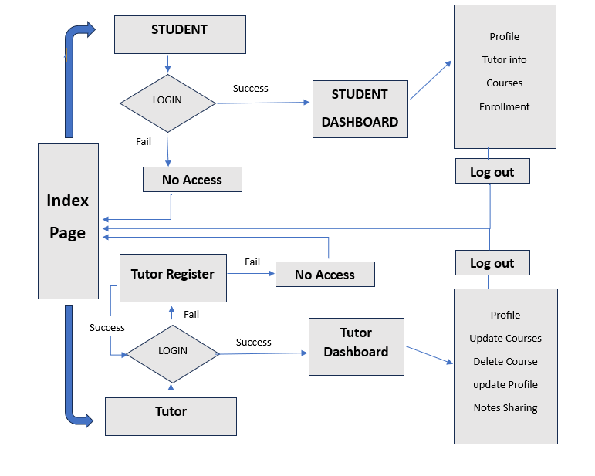
System Architecture

Slide 5
Features
Users:
Can Enroll In Courses
Can Register as Tutor (If they want)
Can also Enroll as a student.
Admin:
Can Add Courses for Tutors
Can Remove Tutors
Can Remove Courses and Edit them

Slide 6
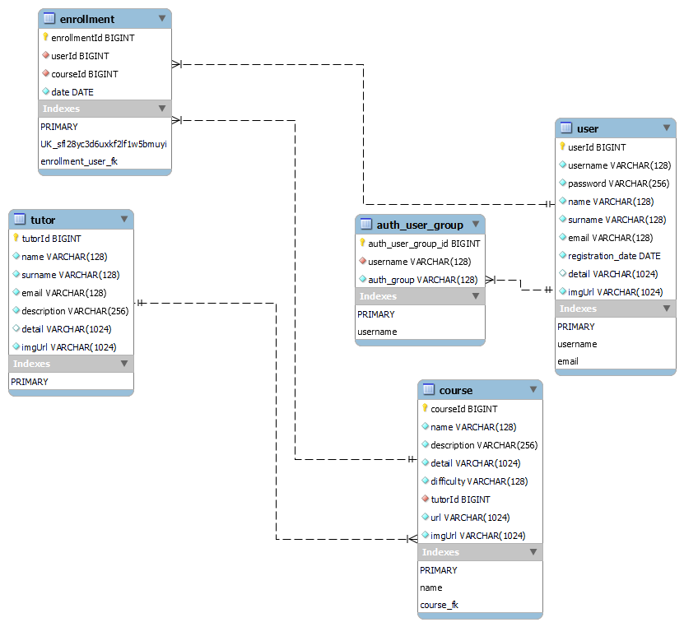
ER Diagram

Slide 7
Use Case Model
Log In
Enroll In Courses
USER
Register As Tutor
Edit Profile Details
Log Out

Slide 8
Use Case Model
Log In
Add Courses
Remove Courses
View Tutors Details
ADMIN
Edit Tutor Details
Remove Tutor
Can Do All Things a User Can
Log Out

Slide 9
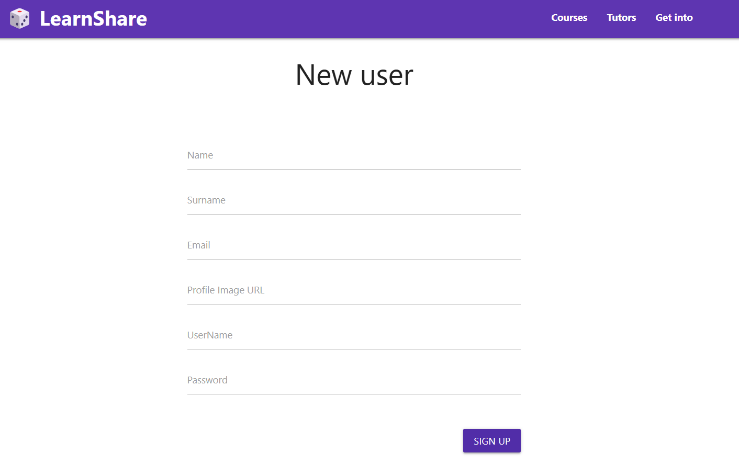
UI Implementation
User Registration

Slide 10
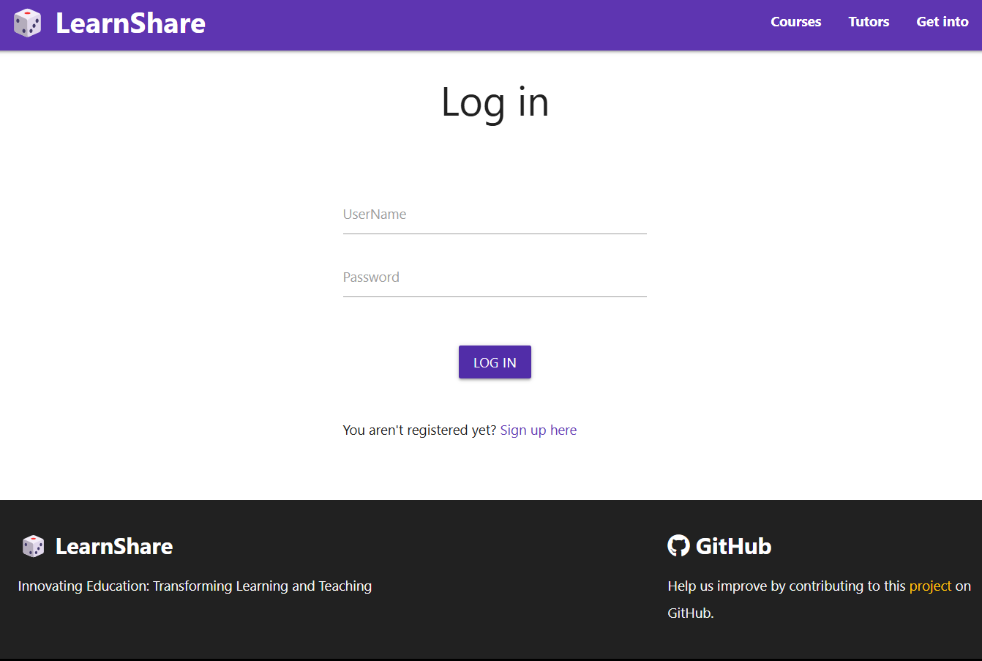
UI Implementation
Login Page

Slide 11
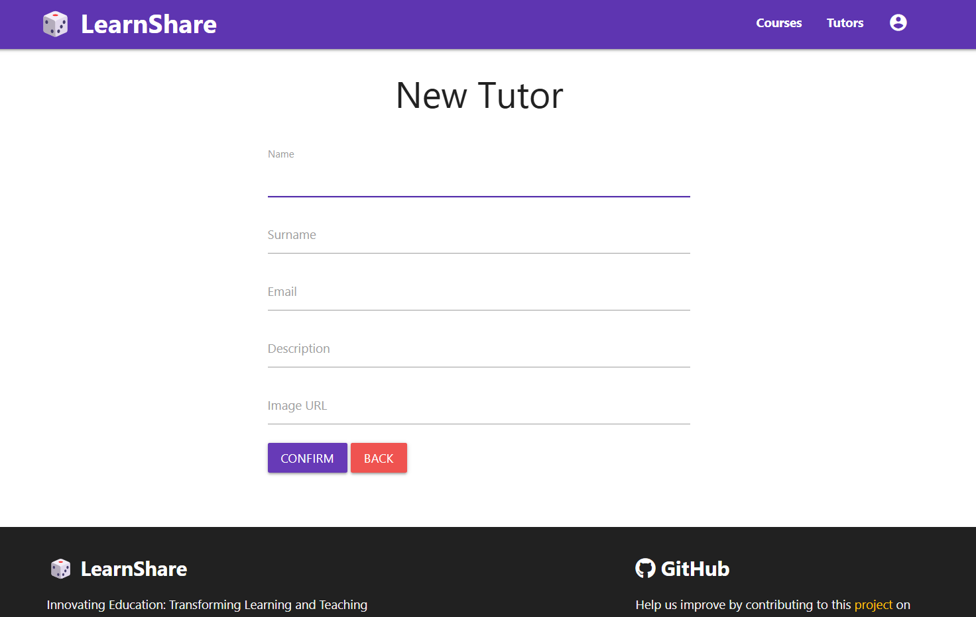
UI Implementation
Tutor Registration

Slide 12
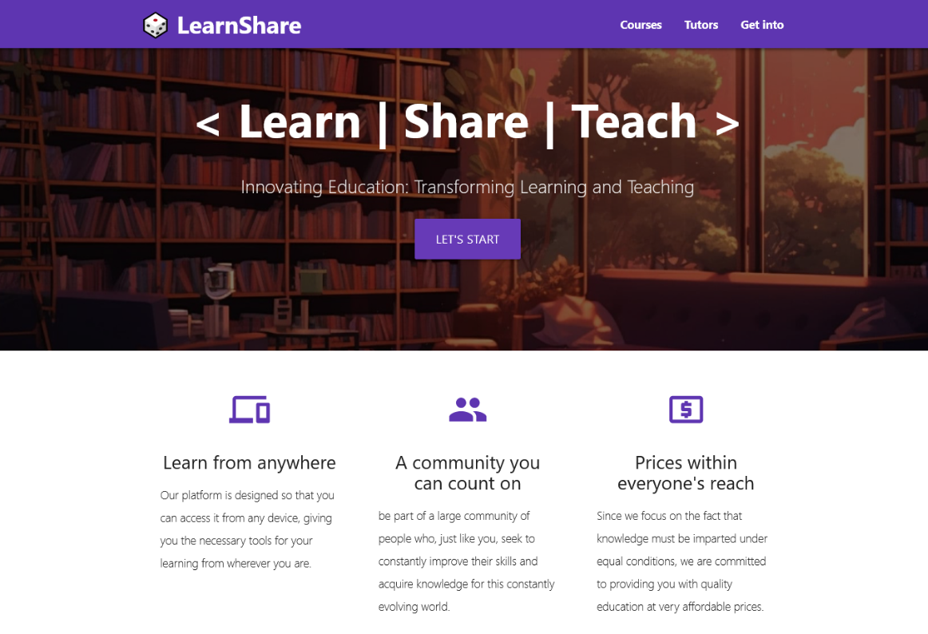
UI Implementation
Index Page

Slide 13
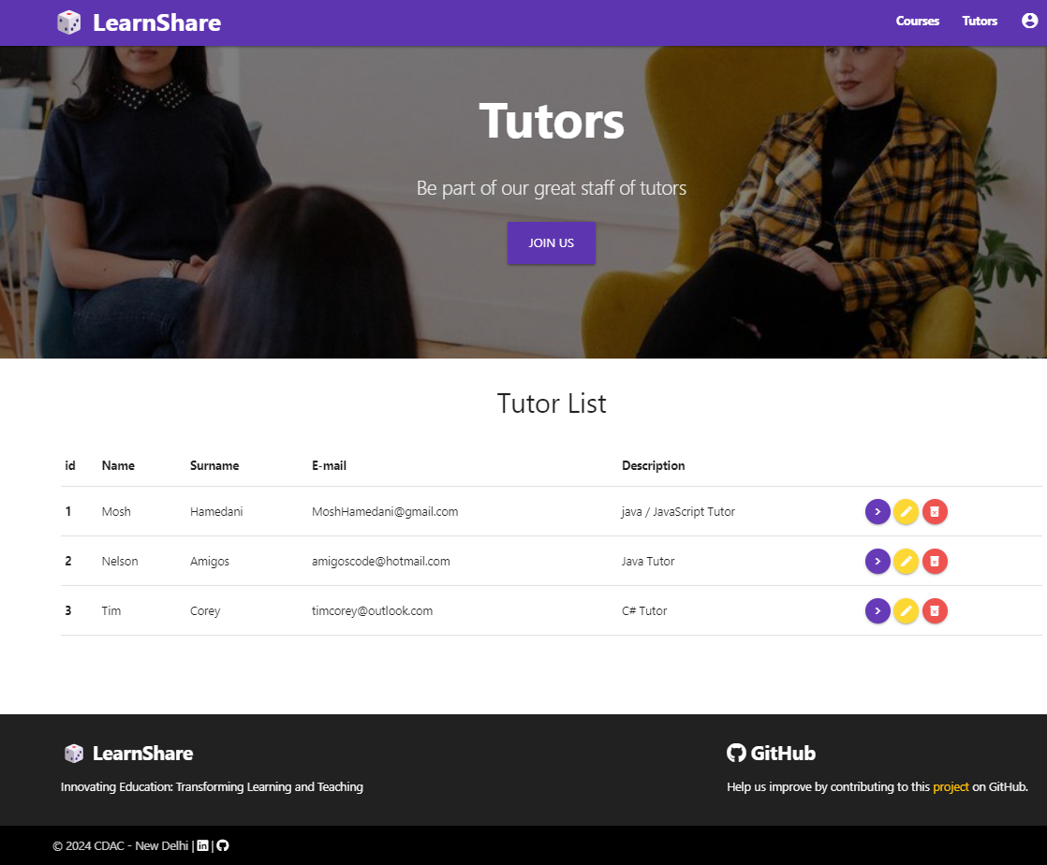
UI Implementation
Tutor Dashboard

Slide 14
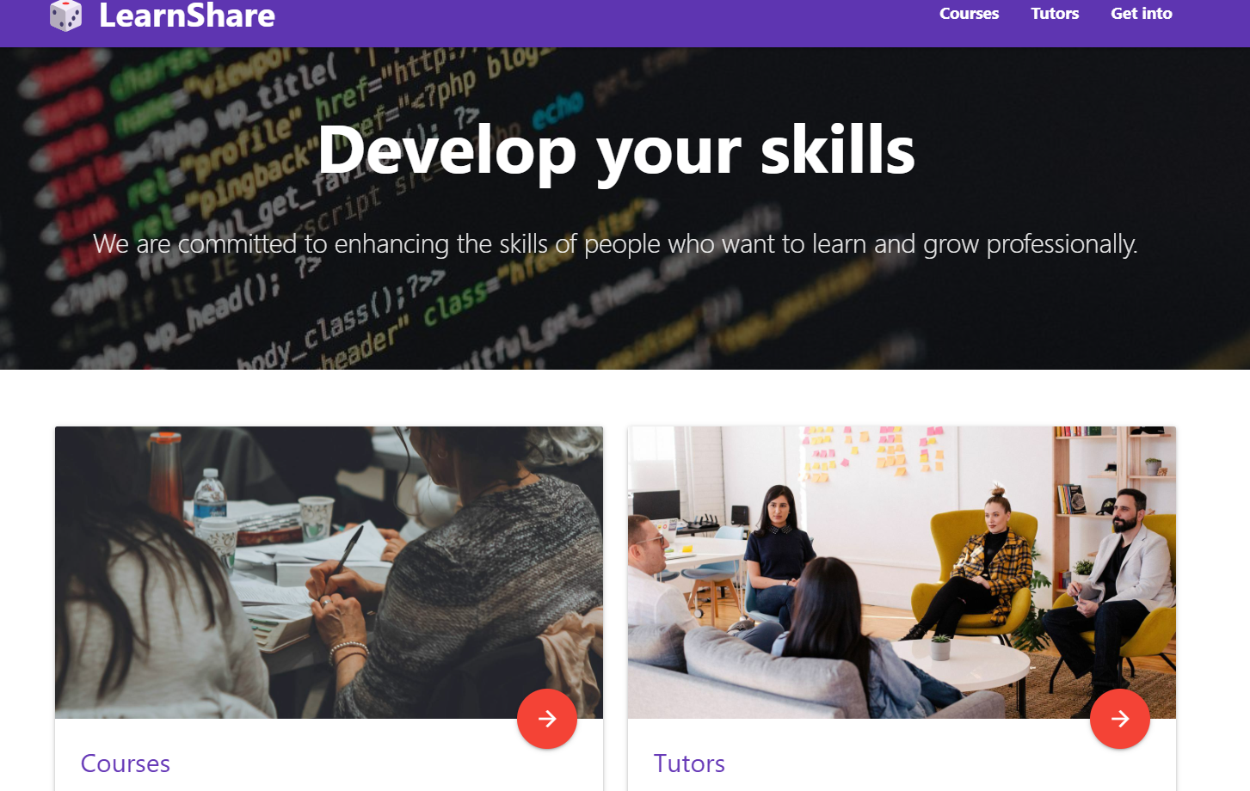
UI Implementation
Student Dashboard

Slide 15
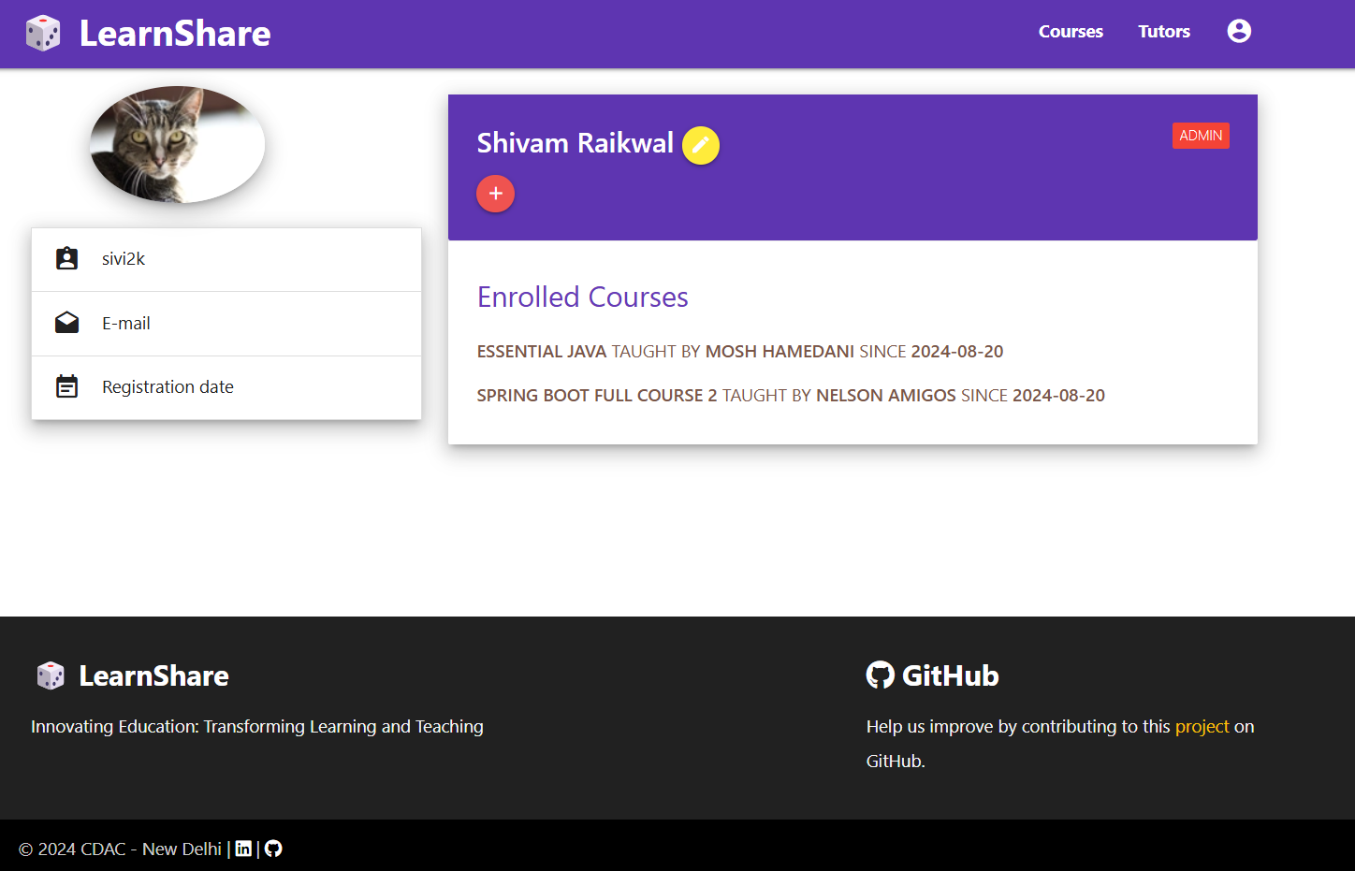
UI Implementation
Profile page

Slide 16
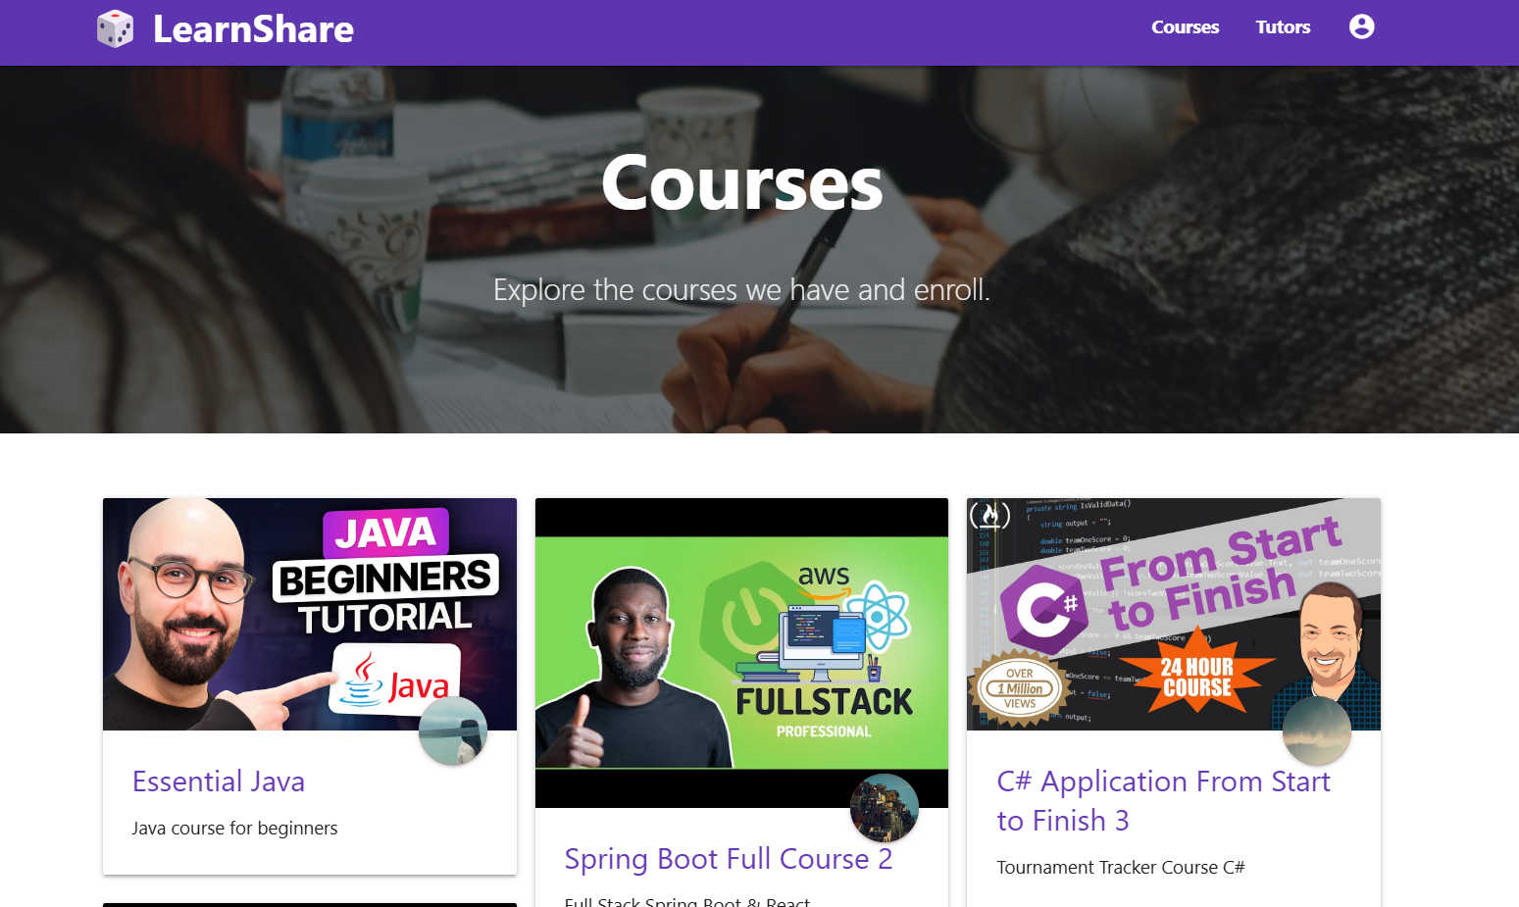
UI Implementation
Course Dashboard

Slide 17
Future Scope
Mock Exams Integration where User can give Mock exams on the go created by the tutor , Depending on the module.
Introduce features like discussion forums, group projects, and peer reviews to foster a collaborative learning environment. This can enhance the learning experience by allowing students to learn from each other
Offer courses in multiple languages to reach a global audience. This can open up new markets and make your platform accessible to non-English speakers.
Tutor can share Notes and other content .

Slide 18
Conclusion
This platform not only streamlines exam preparation by centralizing all necessary resources but also supports continuous learning. Students often face challenges during exams when they can’t find the right content or materials on time, leading to stress and inefficiency. Our platform addresses this issue by providing a comprehensive solution where students can access a wide range of study materials and courses. This ensures they have everything they need in one convenient and user-friendly location, making it easier to focus on their studies and succeed in both exams and general education. By eliminating the need to navigate multiple sites, we help students save time and reduce stress, ultimately enhancing their learning experience and academic performance.

